Slide 1
Simulating Shallow Depth of Field in Portraits Using Generative Models
Zain Nasrullah
https://github.com/ZainNasrullah/CV-DoF-Research
Notes:
Add references & Figure Numbers

Slide 2
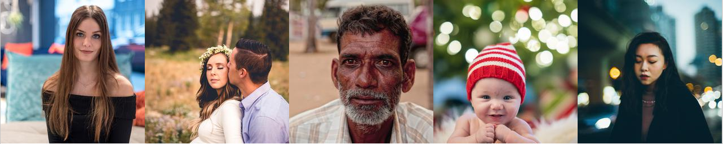
What is Shallow Depth of Field (DoF)?
Subject of the image is in focus while the background is blurred [1]
Bokeh is used to describe the shape light takes when blurred [2]
Considered aesthetically pleasing and dependent on lens design
Figure 1: Shallow depth of field images collected using Flickr API
Notes:
Add references

Slide 3
Table of Contents
Motivation
Methods
Conventional Approaches
Cycle-Consistent Generative Adversarial Networks (CycleGAN)
CycleGAN + Mask Loss
CycleGAN + Mass Overlay
Results
Experimental Setup
Model Comparison
Loss Curves
Limitations
Conclusion

Slide 4
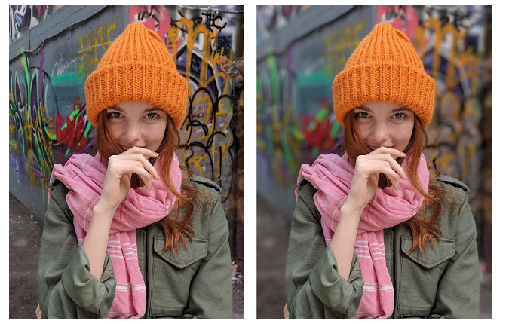
Motivation
Google Research
Lens Blur (2014) – Depth Map Estimate using Stereo Images [3]
Portrait Mode (2017) – Combining Segmentation Mask & Depth Map Estimate [4]
Rear-Facing Pixel 2 Camera Possesses Dual-Pixel Autofocus (DPAF) [5]
Smoothing technique unknown
Segmentation results are good and depth map estimation from a single image is improving as well. However, this work investigates how well a generative model can perform this task.
Figure 2: Original Image (left) and Portrait Mode (Right) on the Pixel 2 [4]
Notes:
Add references

Slide 5
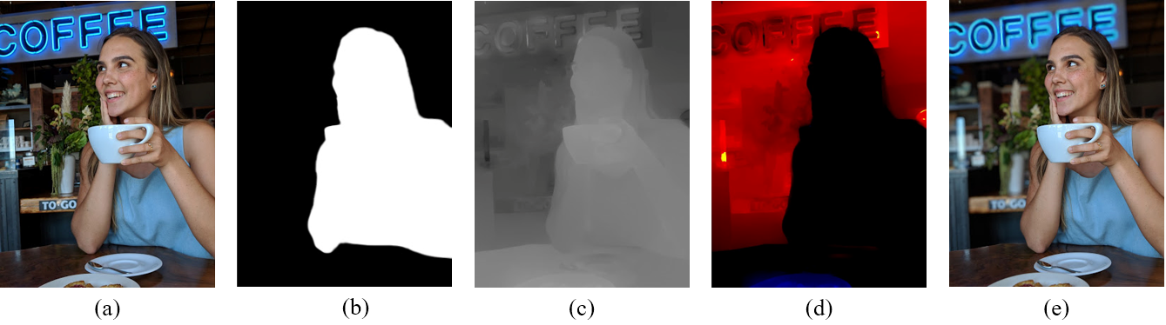
Methods: Conventional Approaches
Figure 3: Google’s Smoothing Approach Step by Step [4]
Input
Segmentation Mask
Depth Map
Combines (b) & (c)
Output
Notes:
Add references

Slide 6
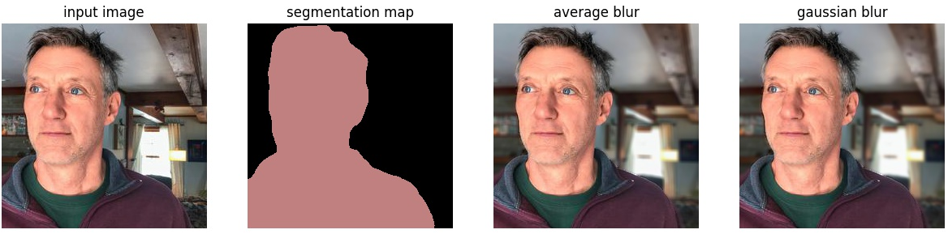
Methods: Conventional Approaches
Figure 4: Image Segmentation (DeepLabV3+) and Manual Smoothing
(5, 5) Kernel
(9, 9) Kernel
Notes:
Needs work

Slide 7
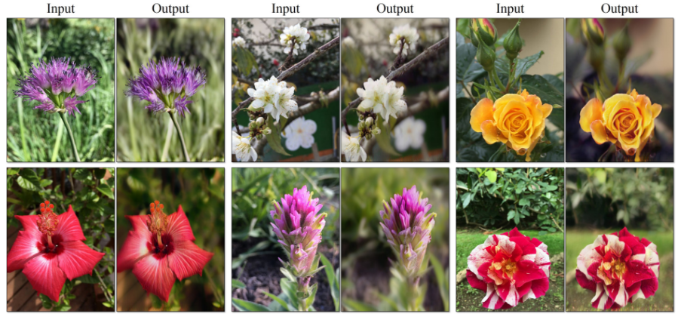
Methods: Cycle-Consistent Generative Adversarial Networks (CycleGAN)
Unpaired Image Translation between Domains A and B [6]
Mixed results when applied to flowers dataset for shallow DoF [6]
Real A x
A to B G
Recovered A
F(G(x))
Cycle
*See Figure 5
Fake B
G(x)
Figure 6: Shallow DoF on Flower Dataset
B to A
F
Send to Discriminator D(G(x))
Figure 5: Cycle-Consistency Visualization
Notes:
add references

Slide 8
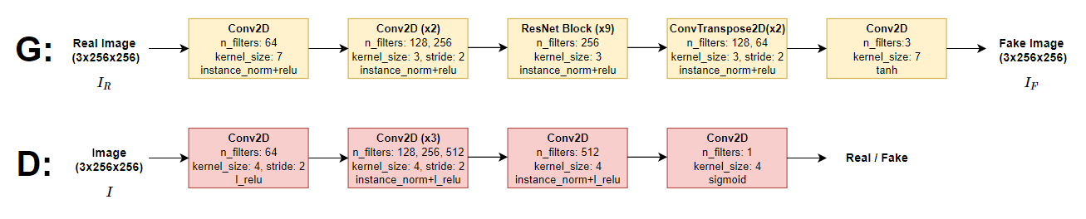
Methods: Cycle-Consistent Generative Adversarial Networks (CycleGAN)
Unpaired Image Translation between Domains A and B [6]
Figure 7: CycleGAN Architecture
Notes:
Add references

Slide 9
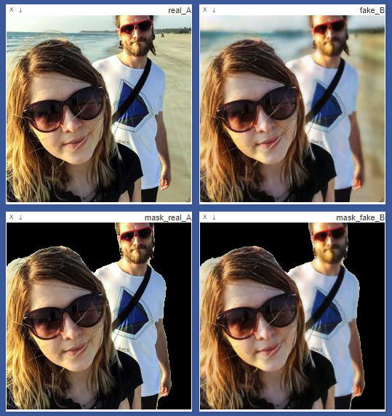
Methods: CycleGAN + Mask Loss
Figure 8: Mask Loss Example
Inspiration taken from Identity-Preserving Face Recovery paper [7]
Goal: Teach a model to recover the original portrait from a stylized version
Solution: Introduce additional loss terms (norm and vgg) to guide the network
Idea: Introduce additional loss terms comparing segmentation masks applied to real and fake images
V ~ VGG19 ReLU 3-2
Compute loss between these two
Notes:
Add loss equations

Slide 10
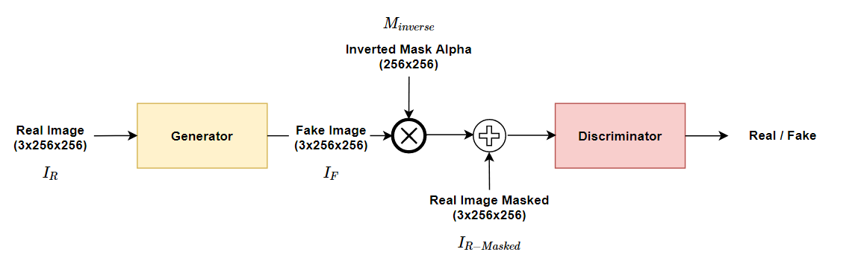
Methods: CycleGAN + Mask Overlay
Inspiration taken from Attention-GAN paper [8]
Goal: Improve object transfiguration with unpaired images
Solution: Use separate networks to detect and transform objects → improves cycle consistency
Idea: Rather than train an attention network, overlay segmented images to guide training
Expected Impacts:
Network only needs to focus on transformation
Loss terms unaffected by how people in images are blurred
Reduced cycle-consistency loss
Figure 8: Mask Overlay Model
Notes:
Add references

Slide 11
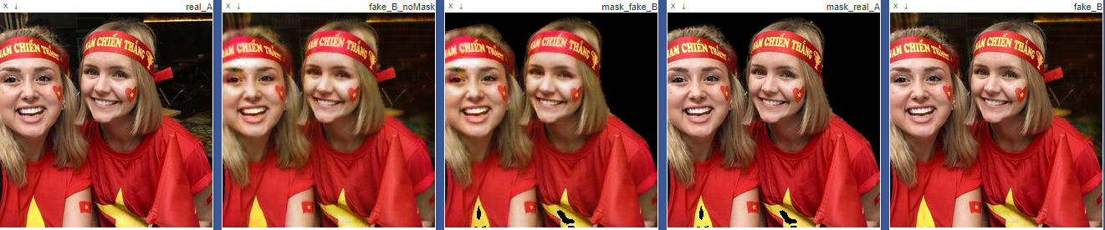
Methods: CycleGAN + Mask Overlay
Inspiration taken from Attention-GAN paper [8]
Goal: Improve object transfiguration with unpaired images
Solution: Use separate networks to detect and transform objects → improves cycle consistency
Idea: Rather than train an attention network, overlay segmented images to guide training
Combine these two
Figure 9: Mask Overlay Example
Input
Generated
Turn these Pixels Off
Add Real Pixels
Output
Notes:
Show what the model is doing

Slide 12
Results: Experimental Setup
Dataset: Queried 4000 images from each group via Flickr API
Shallow Depth of Field Portraits (Any camera) – 2157 retained
Ordinary Portraits (iPhone 7 Camera) – 2370 retained
Image Resolution: 3 x 256 x 256
Batch Size: 1
Training Epochs: 75
50 at LR 0.0002
25 linearly decaying to 0

Slide 13
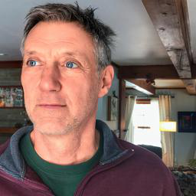
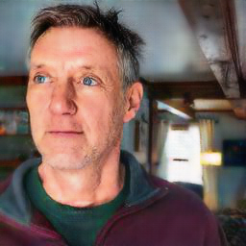
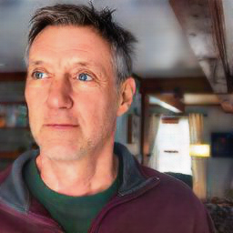
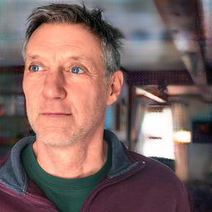
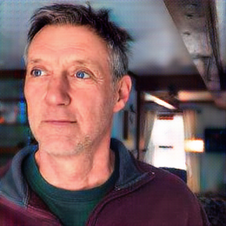
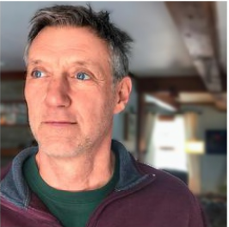
Results: Model Comparison
Figure 10: Comparison of Models and Gaussian Blur Reference
(a) Input Image (b) CycleGAN (c) Mask Loss (d) Mask Overlay (e) Mask Loss + Overlay (f) Manual Smoothing
(training only)

Slide 14
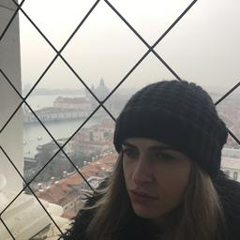
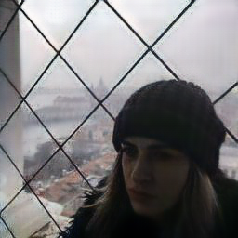
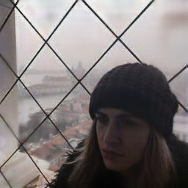
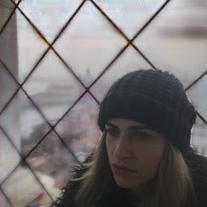
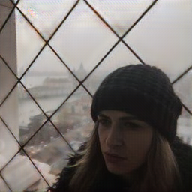
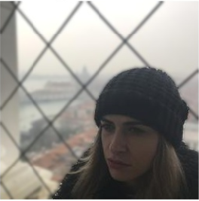

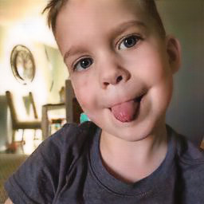
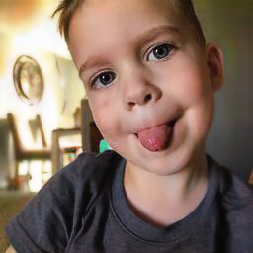
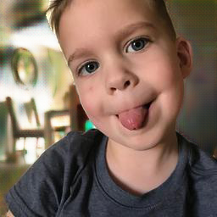
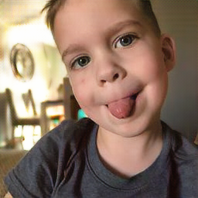
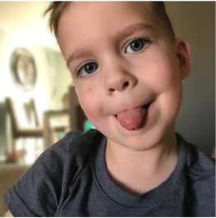
Results: Successes
Figure 11: Success Images
(a) Input Image (b) CycleGAN (c) Mask Loss (d) Mask Overlay (e) Mask Loss + Overlay (f) Manual Smoothing
(training only)

Slide 15
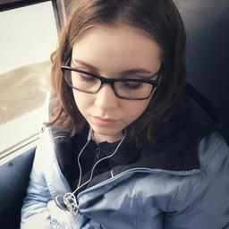
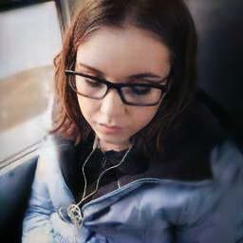
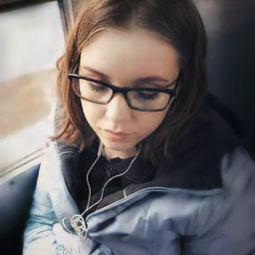
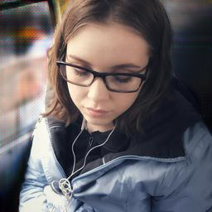
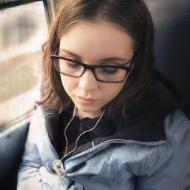
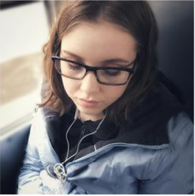
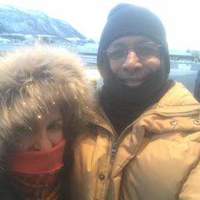
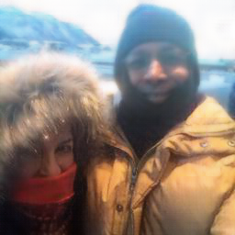
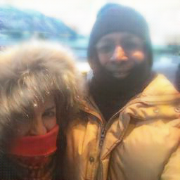
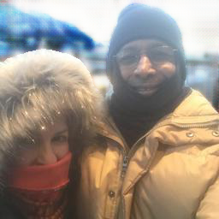
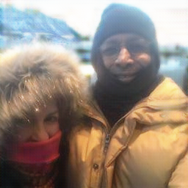
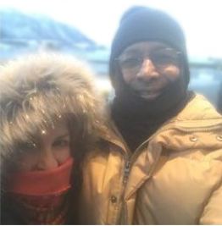
Results: Successes Continued
Figure 12: Success Images
Continued
(a) Input Image (b) CycleGAN (c) Mask Loss (d) Mask Overlay (e) Mask Loss + Overlay (f) Manual Smoothing
(training only)

Slide 16

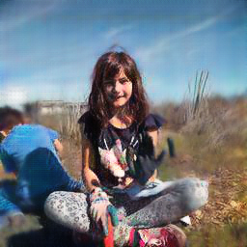
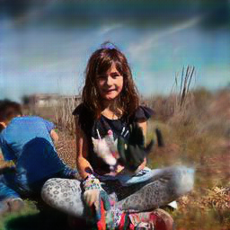
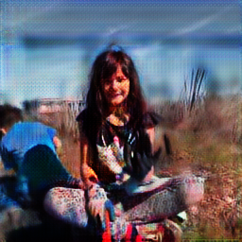
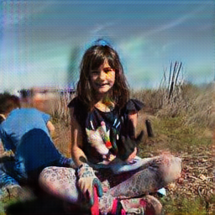
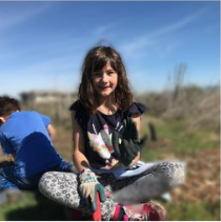
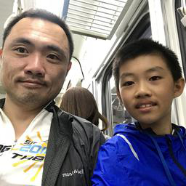
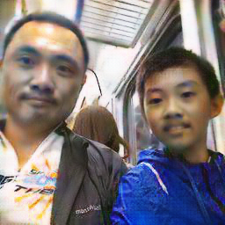
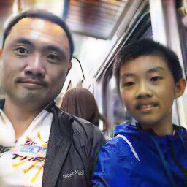
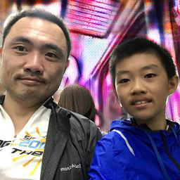
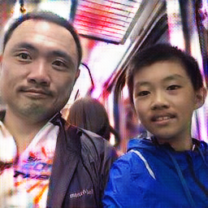
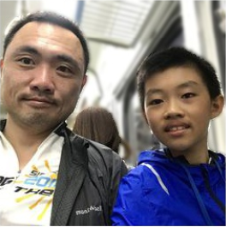
Results: Failures
Figure 13: Failure
Images
(a) Input Image (b) CycleGAN (c) Mask Loss (d) Mask Overlay (e) Mask Loss + Overlay (f) Manual Smoothing
(training only)

Slide 17
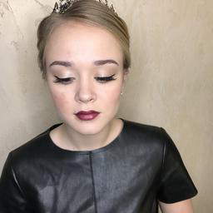











Results: Interesting Cases (Imagining Things)
Figure 14: Model Imagining
(a) Input Image (b) CycleGAN (c) Mask Loss (d) Mask Overlay (e) Mask Loss + Overlay (f) Manual Smoothing
(training only)

Slide 18












Results: More Interesting Cases (Stylized)
Figure 15: Model
Stylizing
(a) Input Image (b) CycleGAN (c) Mask Loss (d) Mask Overlay (e) Mask Loss + Overlay (f) Manual Smoothing
(training only)

Slide 19

Results: Loss Curves
Improved cycle-consistency (expected) using the mask overlay
Figure 16: Average Cycle Loss Comparison

Slide 20




Results: Loss Curves Continued
Mask Loss
Mask Loss + Overlay
Mask and VGG Loss much lower when also using the mask overlay(right)
Person in fake image is less likely to be blurred just by training using the mask
Figure 18: Visual impact of mask loss + overlay
(a) Input
(b) Generated with Mask Loss Only
(c) Generated with Mask Loss + Overlay
Figure 17: Effect of Overlay on Mask Loss
Notes:
Add images to show

Slide 21
Limitations
Artifacts in images
Use a different network architecture
Replace deconvolution upsampling with nearest-neighbor interpolation
Train for longer
Resource requirements of GANs
Long training time before results begin to look realistic
Larger image sizes require substantial GPU memory to train (solution: split image up into blocks?)
Need to train on a large variety of scenes and lighting conditions
Dependent on the segmentation mask
Captures people in the background
Segmentation performance isn’t guaranteed
Worthwhile to investigate how depth can also be used

Slide 22
Conclusion
Dataset collected for unpaired portrait translation
Generative results are far from perfect, but they capture interesting stylistic characteristics from the shallow depth of field domain
Training metrics improved by mask loss and mask overlay
Next steps involve resolving artifacts

Slide 23
References
[1] Nikon. DSLR Camera Basics, 2018. http://imaging.nikon.com/lineup/dslr/basics/19/05.htm.
[2] Nasim Mansurov. What is Bokeh?, 2018. https://photographylife.com/what-is-bokeh.
[3] Carlos Hernández. Lens Blur in the new Google Camera app, 2017. https://research.googleblog.com/2014/04/lens-blur-in-new-google-camera-app.html.
[4] Marc Levoy. Portrait Mode on Pixel 2 and Pixel 2 XL, 2017. https://research.googleblog.com/2017/10/portrait-mode-on-pixel-2-and-pixel-2-xl.html.
[5] Nikon. An Introduction to Dual Pixel Autofocus (DPAF), 2017. http://learn.usa.canon.com/resources/articles/2017/intro-to-dual-pixel-autofocus.shtml.
[6] Jun-Yan Zhu, Taesung Park, Phillip Isola, and Alexei A Efros. Unpaired image-to-image translation using cycle-consistent adversarial networks. arXiv preprint arXiv:1703.10593, 2017.
[7] Fatemeh Shiri, Xin Yu, Fatih Porikli, Richard Hartley, and Piotr Koniusz. Identity-preserving face recovery from portraits. arXiv preprint arXiv:1801.02279, 2018
[8] Xinyuan Chen, Chang Xu, Xiaokang Yang, and Dacheng Tao. Attention-gan for object transfiguration in wild images. arXiv preprint arXiv:1803.06798, 2018.

